Slide 1
UNIT 1: DC CIRCUITS
Lecture 3

Slide 2
Kirchhoff’s Law
Ohm’s law by itself is not sufficient to analyze circuits.
However, when it is coupled with Kirchhoff’s two laws, we have a sufficient, powerful set of tools for analyzing a large variety of electric circuits.
These laws are:
Kirchhoff’s Current Law (KCL)
Kirchhoff’s Voltage Law (KVL)

Slide 3
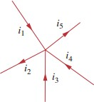
Kirchhoff’s Current Law (KCL)
It states that:
“the algebraic sum of currents entering a node is zero”. OR
“ Sum of currents entering a node = Sum of currents leaving a node “
Based on Law of Conservation of Charge.
Mathematically, ∑ 𝐼 = 0

Slide 4
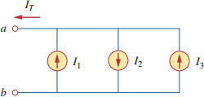
QUICK QUIZ (Poll 1)
KCL equation for the given network is:
A. 𝐼₁ + 𝐼₂ + 𝐼₃
B. 𝐼₁ + 𝐼₂ − 𝐼₃
C. 𝐼₁ − 𝐼₂ + 𝐼₃
D. -𝐼₁ − 𝐼₂ + 𝐼₃

Slide 5
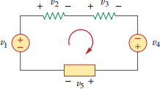
Kirchhoff’s Voltage Law (KVL)
It states that:
“algebraic sum of all voltages around a closed path (or loop) is zero.”
OR
“ Sum of voltage drops = Sum of voltage rises.”
Based on Law of Conservation of Energy
Mathematically, ∑ 𝑉 = 0

Slide 6
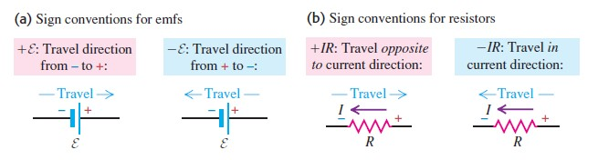
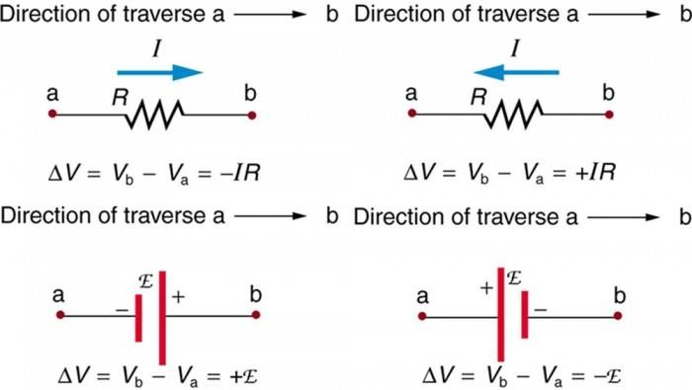
Sign Convention for KVL

Slide 7
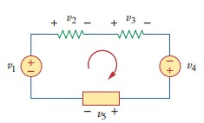
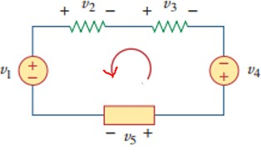
Let us Recall!
Taking Clockwise direction (Def. 1):
+𝑉₁ − 𝑉₂ − 𝑉₃ + 𝑉₄ − 𝑉₅ = 0
Taking Anti-clockwise direction(Def. 1):
−𝑉₄ + 𝑉₃ + 𝑉₂ − 𝑉₁ + 𝑉₅ = 0
Voltage rise = Voltage drop
+𝑉₁ + 𝑉₄ = 𝑉₂ + 𝑉₃ + 𝑉₅

Slide 8
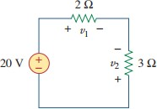
QUICK QUIZ (Poll 2)
Find voltages 𝑉₁ and 𝑉₂ in the given circuit:
A. 𝑉₁ = 16 𝑉 𝑎𝑛𝑑 𝑉₂ = 12 𝑉
B. 𝑉₁ = 16 𝑉 𝑎𝑛𝑑 𝑉₂ = −8 𝑉
C. 𝑉₁ = 8 𝑉 𝑎𝑛𝑑 𝑉₂ = −12 𝑉
D. 𝑉₁ = −12 𝑉 𝑎𝑛𝑑 𝑉₂ = 8 𝑉

Slide 9
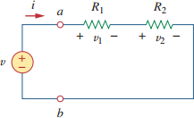

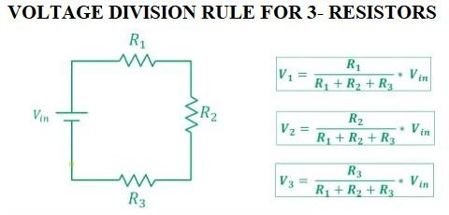
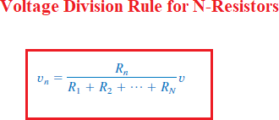
Voltage Division Rule
The important relations are:

Slide 10
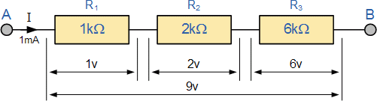
Example for Voltage Division Rule

Slide 11
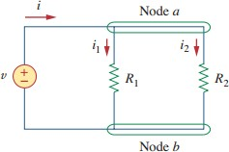

Current Division Rule
The important relations are:

Slide 12
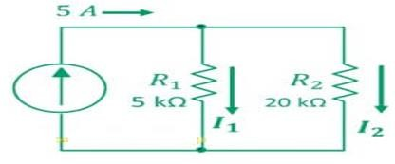
QUICK QUIZ (Poll 3)
Find current across two resistors?
A. 𝐼₁ = 4 𝐴 𝑎𝑛𝑑 𝐼₂ = 16 𝐴
B. 𝐼₁ = −2 𝐴 𝑎𝑛𝑑 𝐼₂ = 1 𝐴
C. 𝐼₁ = 4 𝐴 𝑎𝑛𝑑 𝐼₂ = 1 𝐴
D. 𝐼₁ = 1 𝐴 𝑎𝑛𝑑 𝐼₂ = 4 𝐴

Slide 13
Applications of Kirchhoff’s Laws
They can be used to analyze any electrical circuit.
Computation of current and voltage of complex circuits.

Slide 14
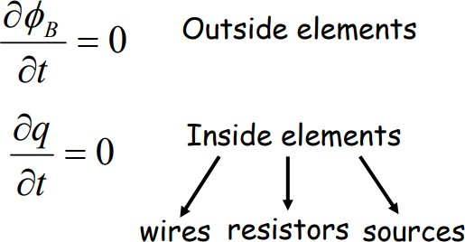
Limitations of Kirchhoff’s Laws
The limitation of Kirchhoff’s both laws is that it works under the assumption that there is no fluctuating magnetic field in the closed loop and the current flows only through conductors and wires.

Slide 15
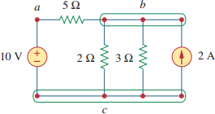
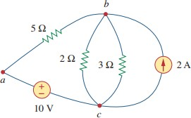
Nodes, Branches, and Loops
A branch represents a single element such as a voltage source or a resistor.
A node is the point of connection between
two or more branches.
A loop is any closed path in a circuit
NOTE:
Two or more elements are in series if they exclusively share a single node and consequently carry the same current.
Two or more elements are in parallel if they are connected to the same two nodes and consequently have the same voltage across them.

Slide 16
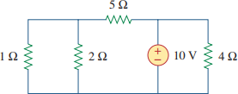
QUICK QUIZ (Poll 4)
How many branches, nodes and independent loops are present in the given circuit?
A. b=3, n=5, l=6
B. b=5, n=3, l=6
C. b=5, n=3, l=3
D. b=3, n=5, l=3

